Slide 1



JAIPUR ENGINEERING COLLEGE AND RESEARCH CENTRE
CRT TECHNICAL CLASS
of
SOFTWARE ENGINEERING
By:
Madhu Choudhary Asst. Prof., Dept. of CSE
JECRC, Jaipur
1

Slide 2
VISION AND MISSION OF INSTITUTE
VISION
To become renowned centre of outcome based learning and work towards academic, professional, cultural and social enrichments of the lives of individual and communities”
MISSION
1. Focus on evaluation of learning outcomes and motivate students to inculcate research aptitude by project based learning.
2. Identify areas of focus and provide platform to gain knowledge and solutions based on informed perception of Indian, regional and global needs.
3. Offer opportunities for interaction between academia and industry.
4. Develop human potential to its fullest extent so that intellectually capable and imaginatively gifted leaders can emerge in a range of professions.
1

Slide 3
VISION AND MISSION OF DEPARTMENT
VISION
To become renowned Centre of excellence in computer science and engineering and make competent engineers & professionals with high ethical values prepared for lifelong learning.
MISSION
M1: To impart outcome based education for emerging technologies in the field of computer science and engineering.
M2: To provide opportunities for interaction between academia and industry.
M3: To provide platform for lifelong learning by accepting the change in technologies
M4: To develop aptitude of fulfilling social responsibilities.
1

Slide 4
CONTENTS (TO BE COVERED)
AGILE PROCESS MODEL
SOFTWARE REQUIREMENT
TYPES OF REQUIREMENTS
REQUIREMENT ANALYSIS TASKS
SRS (SOFTWARE REQUIREMENTS SPECIFICATION)
PURPOSE AND CHARACTERISTICS OF GOOD SRS
DATA DICTIONARY
DATA MODELING
CARDINAL ITY AND MODALITY RELATIONSHIP
ER DIAGRAM
ER DIAGRAM – ENTITY & ATTRIBUTES
ER DIAGRAM – TYPES OF ATTRIBUTES
1

Slide 5
CONTENTS (TO BE COVERED)
FUNCTION MODELING
DFD (DATA FLOW DIAGRAM)
DFD SYMBOLS &NOTATION
LEVELS OF DFD
0 – LEVEL DFD
1 – LEVEL DFD
2 – LEVEL DFD
TYPES OF DFD – LOGICAL DFD
TYPES OF DFD – PHYSICAL DFD
1

Slide 6
FUNCTION MODELING
In software engineering a function model or functional model is a structured representation of the functions (activities, actions, processes, operations) within the modeled system or subject area.
A function model is a graphical representation of an enterprise's function within a defined scope.
The purposes of the function model are to describe the functions and processes
Function modeling is done via DFD.
1

Slide 7
DFD (DATA FLOW DIAGRAM)
A Data Flow Diagram is a graphical representation of flow of data through information system.
DFD can be used to visualize a data processing.
DFD shows what kind of data will be input to the system and what data is received as the output.
Focus on the movement of data between external entities and processes, and between processes and data stores.
1

Slide 8
WHY DFD?
DFD has of been used due to the following reasons:
Provides an overview of-
What data a system processes
What transformations are performed
What data are stored
What results are produced and where they flow
Graphical nature makes it a good communication tool between-
User and analyst
Analyst and System designer
1

Slide 9
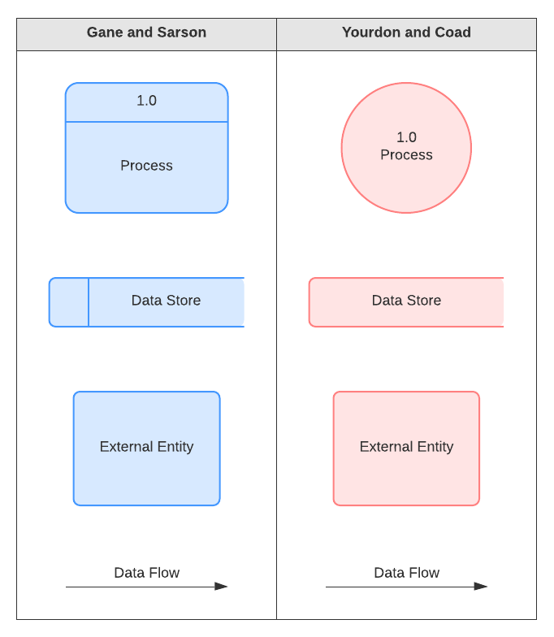
DFD SYMBOLS &NOTATION
External Entity - People or organizations that send data into the system or receive data from the system.
Process - Models what happens to the data i.e. transforms incoming data into outgoing data.
Data Store - Represents permanent data that is used by the system.
Data Flow - Models the actual flow of the data between the other elements.
1

Slide 10
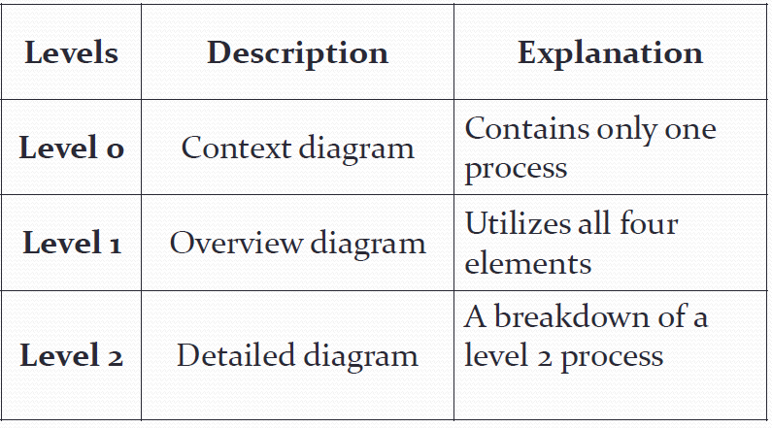
LEVELS OF DFD
There is no rule as to how many levels of DFD that can be used.
1

Slide 11
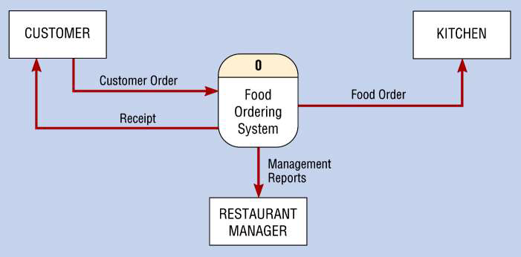
0 – LEVEL DFD
1 process represents the entire system.
Data arrows show input and output.
Data Stores NOT shown. They are within the system.
1

Slide 12
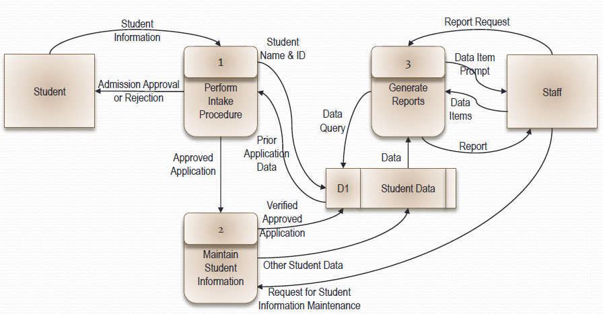
1 – LEVEL DFD
The SRS precisely defines the software product that will be built.
Level 1 DFD, must balance with the context diagram it describes.
Input going into a process are different from outputs leaving the process.
Data stores are first shown at this level.
1

Slide 13
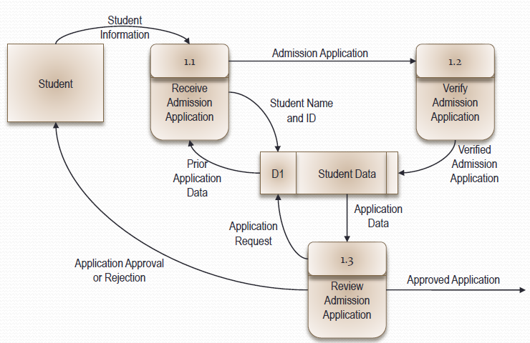
2 – LEVEL DFD: Process 1, Perform Intake Procedure
Level 2 DFD must balance with the Level 1 it describes.
Input going into a process are different from outputs leaving the process.
Continue to show data stores.
1

Slide 14
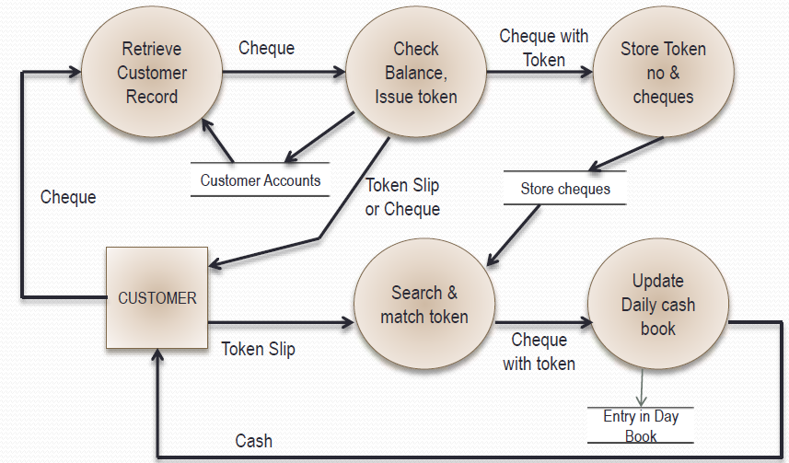
TYPES OF DFD – LOGICAL DFD
A logical data flow diagram focuses on the business and how the business operates. It is not concerned with how the system will be constructed.
We can ignore implementation specifics such as, computer configuration, data storage technology, communication or message passing methods by focusing on the functions performed by the system, such as, data collection, data to information transformation and information reporting.
Logical DFD for Cheque Encashment Ex.
1

Slide 15
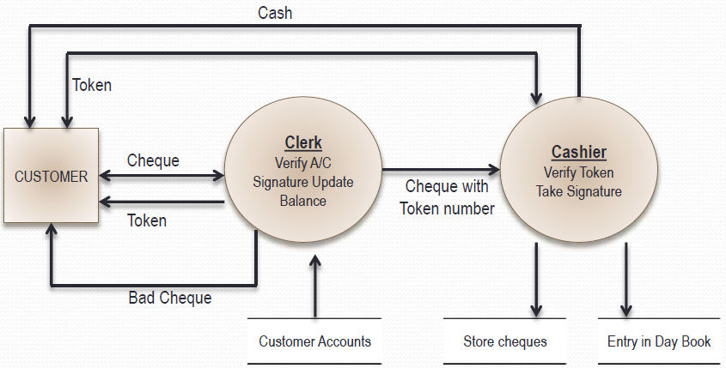
TYPES OF DFD – PHYSICAL DFD
A physical data flow diagram shows how the system will be implemented, including the hardware, software, files, and people in the system. It is developed such that the processes described in the logical data flow diagrams are implemented correctly to achieve the goal of the business.
Physical DFD for Cheque Encashment
1

Slide 16
DFD MCQ’s
1. In a DFD external entities are represented by a
a. Rectangle
b. Ellipse
c. Diamond shaped box
d. Circle
2. External Entities may be a
a. Source of input data only
b. Source of input data or destination of results
c. Destination of results only
d. Repository of data
3. A data store in a DFD represents
a. A sequential file c. A repository of data
b. A disk store d. A random access memory
1

Slide 17
DFD MCQ’s CONT...
4. By an external entity we mean a
a. Unit outside the system being designed which can be controlled by an analyst
b. Unit outside the system whose behavior is independent of the system being designed
c. A unit external to the system being designed
d. A unit which is not part of DFD
5. A data flow can
a. Only enter a data store
b. Only leave a data store
c. Enter or leave a data store
d. Either enter or leave a data store but not both
6. A circle in a DFD represents
a. A data store b. A an external entity
c. A process d. An input unit
1

Slide 18
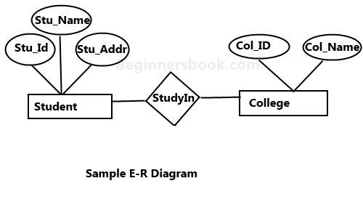
UML (UNIFIED MODELING LANGUAGE) DIAGRAM
An Entity–relationship model (ER model) describes the structure of a database with the help of a diagram, which is known as Entity Relationship Diagram (ER Diagram). An ER model is a design or blueprint of a database that can later be implemented as a database. The main components of E-R model are: entity set, attribute and relationship set.
1

Slide 19
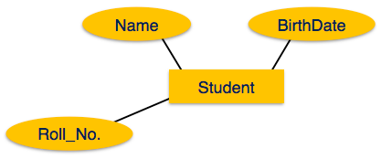
ER DIAGRAM – ENTITY & ATTRIBUTES
Entity - Entities are represented by means of rectangles. Rectangles are named with the entity set they represent.
Attributes - Attributes are the properties of entities. Attributes are represented by means of ellipses. Every ellipse represents one attribute and is directly connected to its entity (rectangle).
1

Slide 20
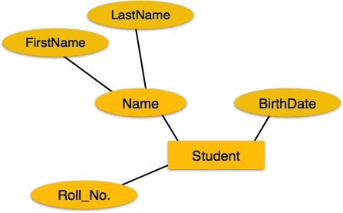
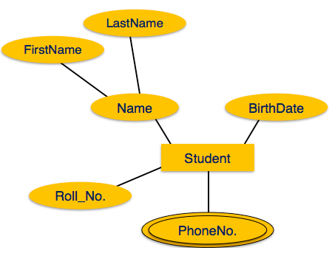
ER DIAGRAM – TYPES OF ATTRIBUTES
Composite Attribute
Multivalued Attribute
1

Slide 21
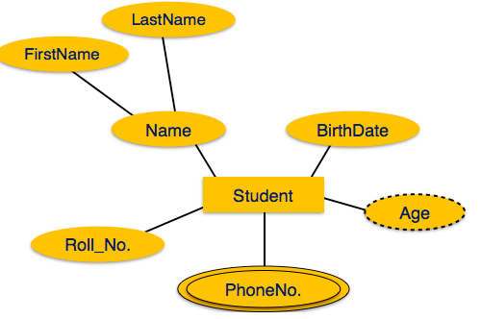
ER DIAGRAM – TYPES OF ATTRIBUTES CONT…
3. Derived attributes are depicted by dashed ellipse.
1

Slide 22
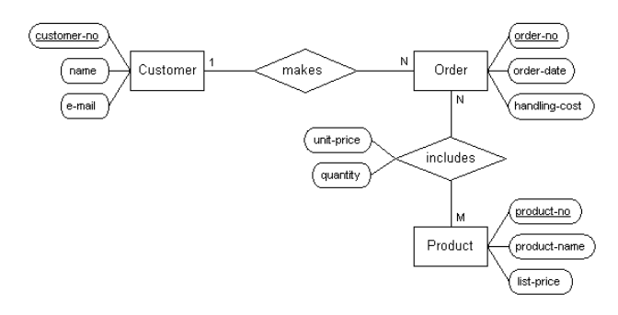
ER – DIAGRAM EXAMPLE
1

Slide 23



Madhu Choudhary(Asst. Prof., CSE), JECRC, JAIPUR

